Slide 1


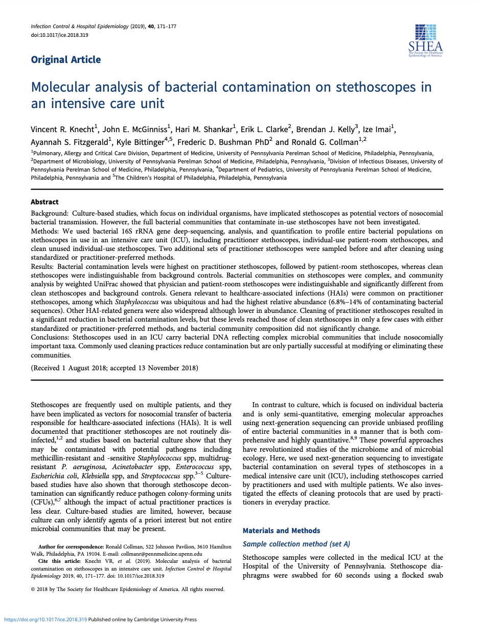

Selling With Evidence Molecular analysis of bacterial contamination on stethoscopes in an intensive care unit Knecht, et al.
“But our practitioners already sterilize their stethoscopes.”
Notes:
Study by UPenn explores stethoscope cleaning and contamination within an ICU

Slide 2


The Study
Set A - Baseline Contamination Levels (Control)
Clean disposable stethoscopes
Used disposable stethoscopes
in patient rooms
Used standard stethoscopes
carried by healthcare practitioners
Notes:
The study analyzes 3 sets of stethoscopes, the 1st being Set A:
Experimenters measured contamination levels of 3 different groups of SS prior to cleaning
Their conclusion?

Slide 3
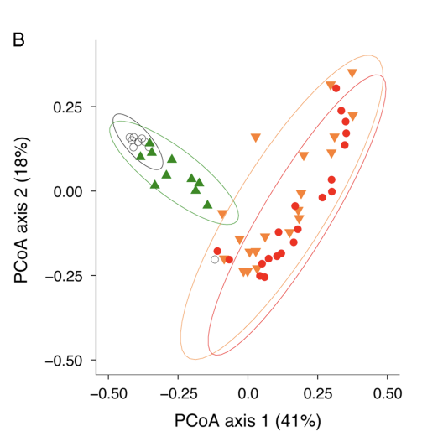
Results
Background Controls
Clean Stethoscopes
Patient Room
Stethoscopes
Practitioner
Stethoscopes
Notes:
Graph displays Set A
Each dot denotes a culture sample from respective group
Orange & Red do not overlap with Green, so yk they are contaminated as is

Slide 4




The Study
Set B – Standardized Cleaning Method
Disposable stethoscopes in patient rooms
Pre-Swab
Standard Cleaning
Post-Swab
Notes:
Pre-swab before the researcher cleaned entire diaphragm standard method: hydrogen peroxide for 60 seconds, let it dry, and then swabbed the diaphragm again.

Slide 5
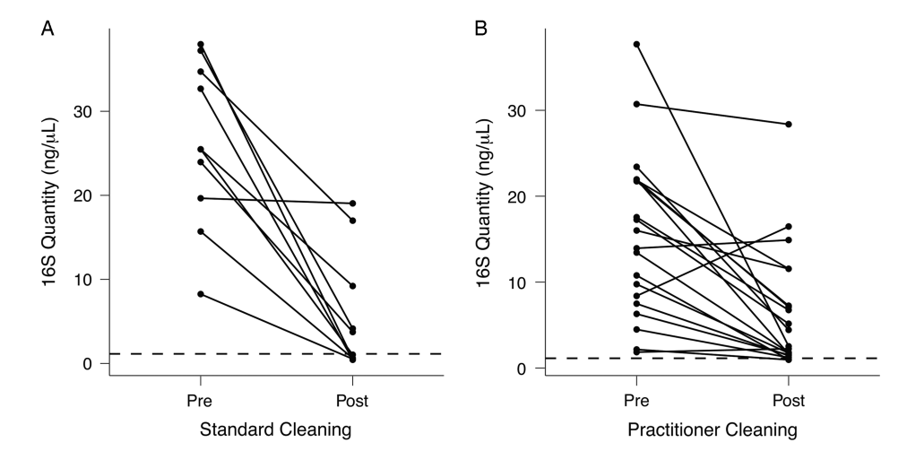
Results
Set B
Standardized cleaning
50% efficacy rate
Notes:
Only 5/10 stethoscopes meeting the acceptable level of cleanliness
Efficacy – the power to produce a desired result

Slide 6
The Study
Set C – Practitioner-Preferred Cleaning Method
Standard stethoscopes carried by healthcare practitioners
Pre-Swab
Practitioner Cleaning
Post-Swab
Notes:
The diaphragm was pre-swabbed, then the left side (½) of diaphragm was cleaned by researchers and returned to practitioners who were instructed to clean it using their own method (ie. hydrogen peroxide, alcohol, or bleach). Right ½ was swabbed after practitioner completed their own cleaning.
To ensure that the pre-cleaning swab would not affect the post- cleaning communities, the stethoscope diaphragm was sampled as described above, but only the left half of the diaphragm was swabbed.

Slide 7
Results
Set C
Practitioner-preferred
10% efficacy rate
Notes:
Practitioner-preferred cleaning led to an inconsequential efficacy rate of 10%, with only 2 of 20 stethoscopes dropping to an acceptable level of cleanliness

Slide 8

Results
50%
10%
Standard Cleaning
Practitioner-preferred

Slide 9

Conclusion
“Cleaning reduces contamination but does not bring the bacterial biomass down to the level of clean stethoscopes nor does it significantly change the overall community composition.”

Slide 10
Key Takeaways
Current cleaning methods reduce but did not eliminate contamination
Practitioner stethoscopes carried the highest levels of bacterial contamination
Stethoscopes are still prominent vectors of HAI transfer
Knecht VR, McGinniss JE, Shankar HM, Clarke EL, Kelly BJ, Imai I, et al. Molecular analysis of bacterial contamination on stethoscopes in an intensive care unit. Infect Control Hosp Epidemiol. 2019;40(2):171-177.

Slide 11
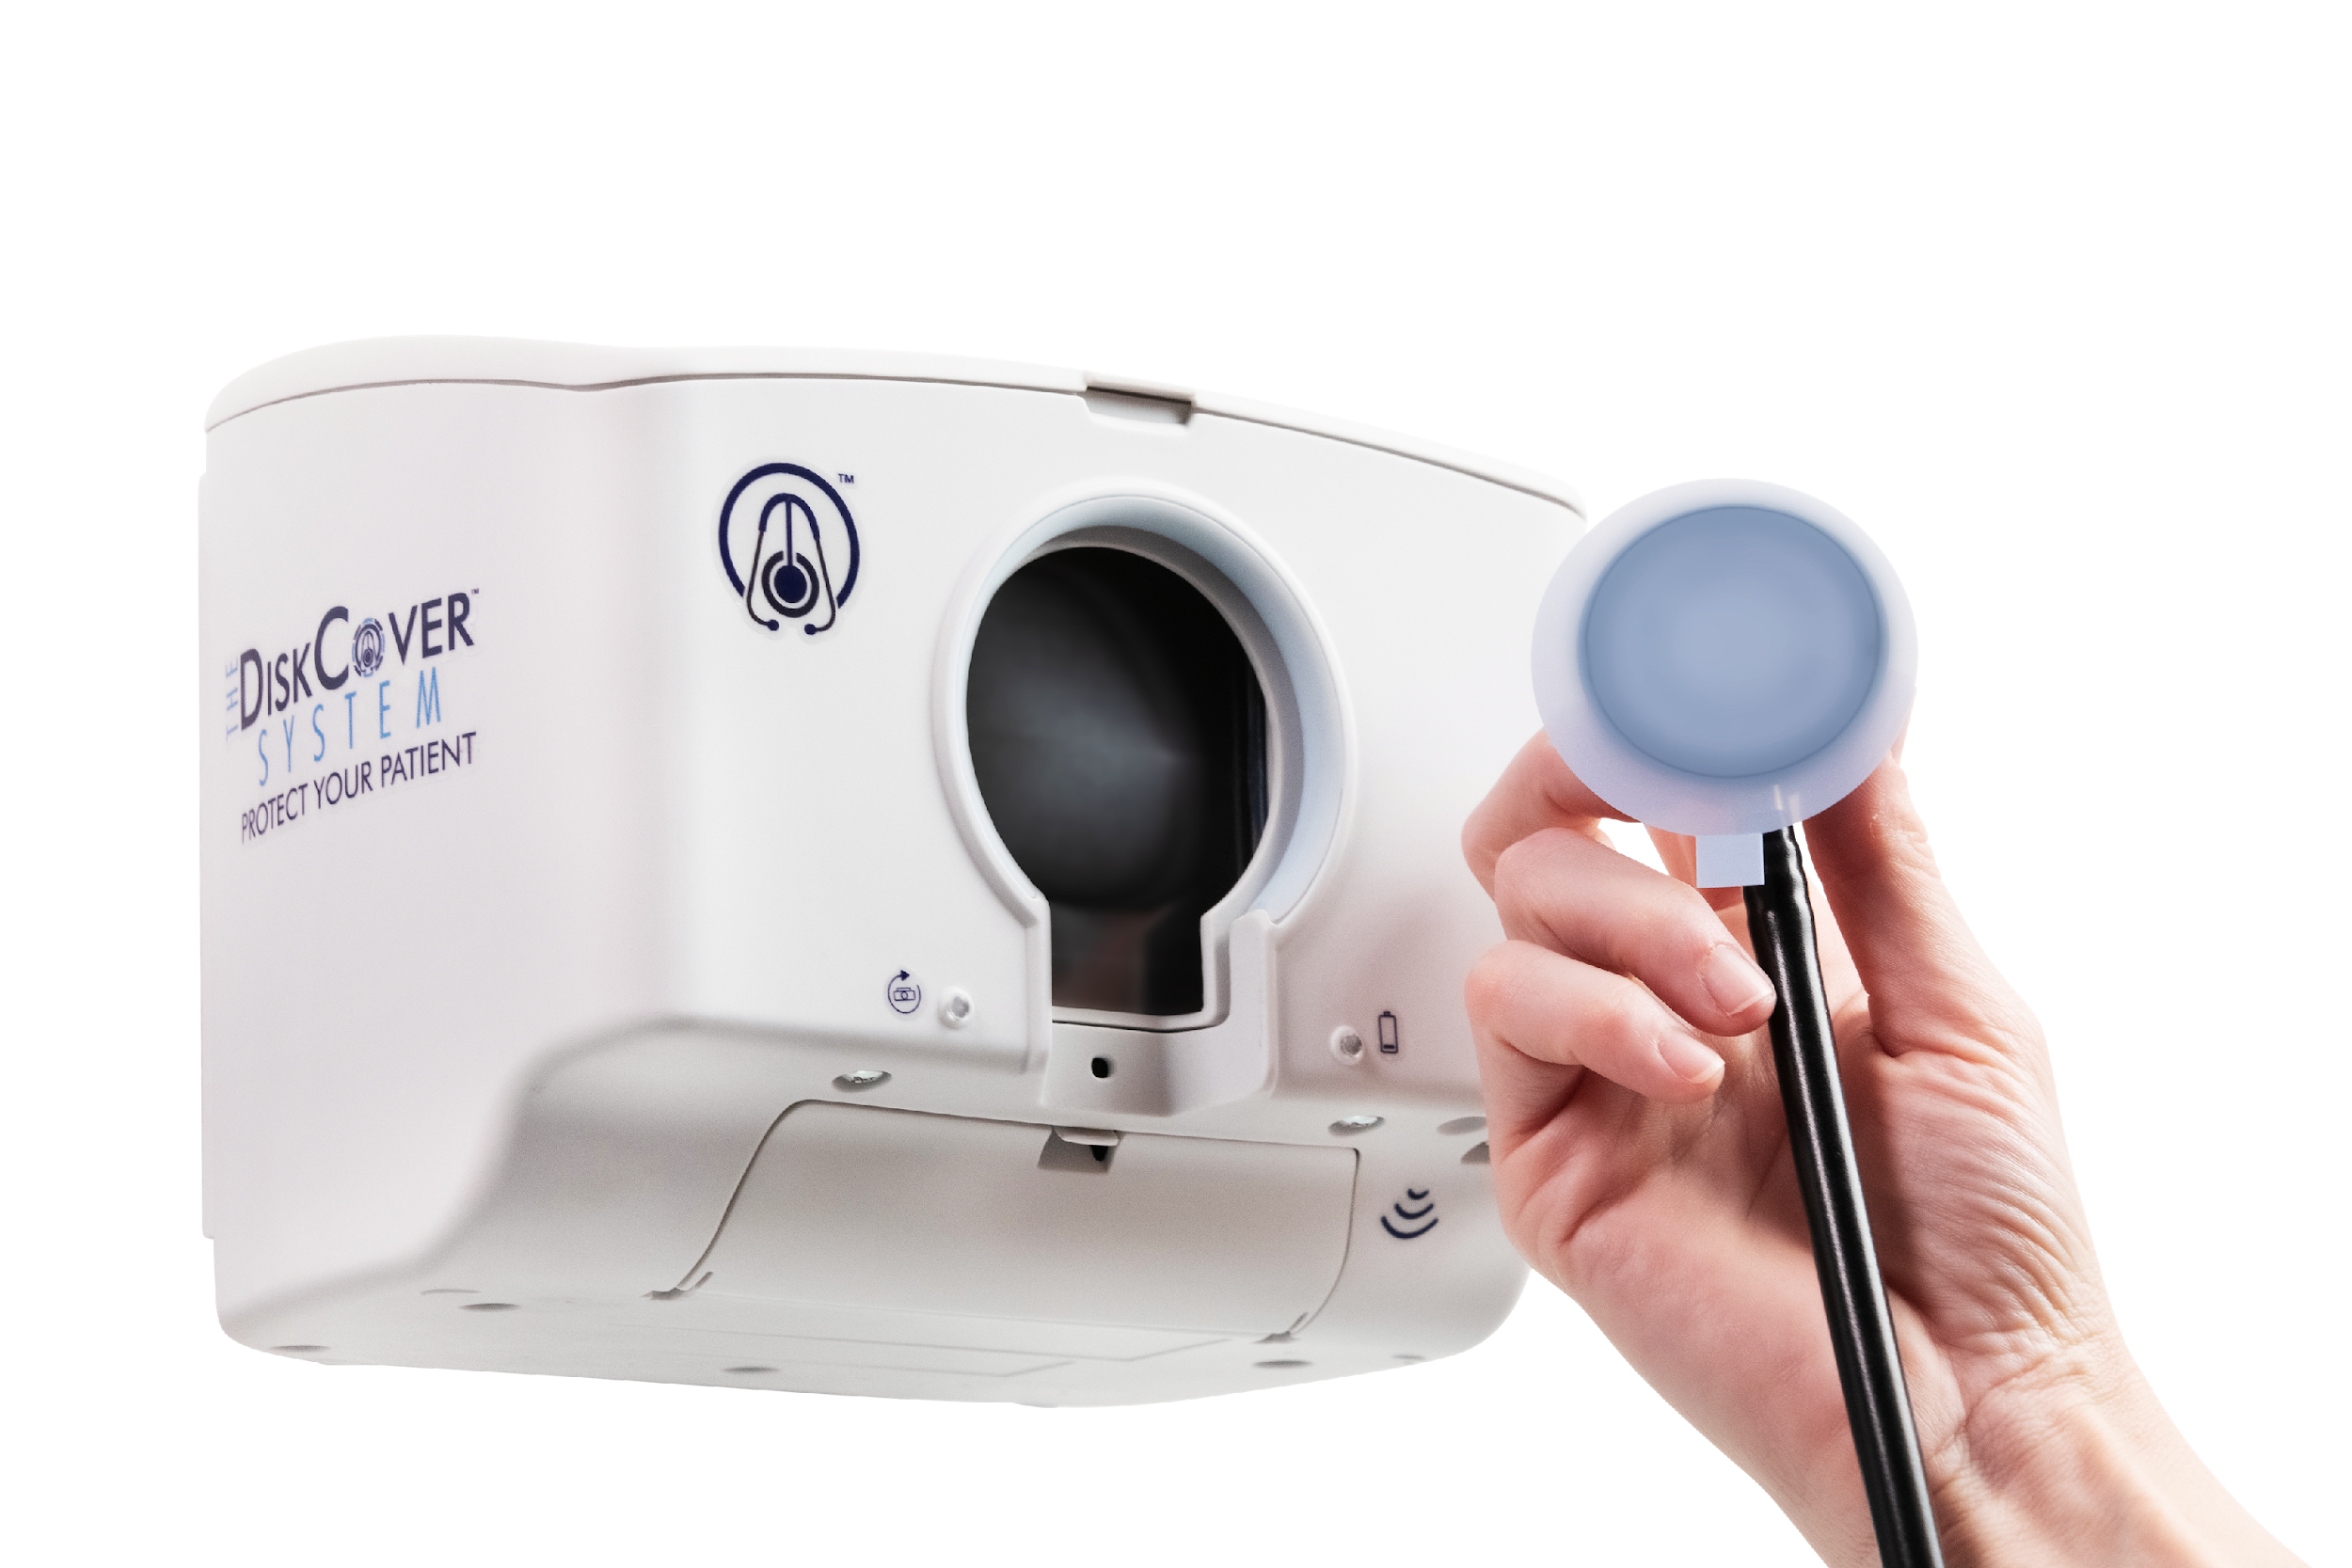

Protection Against HAIs
=
100%
Notes:
Not to beat a dead horse…

